Slide 1
Course Code: CSE 303 Course Title: Data Communication
Green Networking Research Group
Dept. of Computer Science and Engineering, University of Dhaka

Slide 2
Recommended book
Text Book:
Data Communications and Networking
Behrouz A. Forouzan,
4th EditionMcGraw-Hill
Reference Books:
Data and Computer Communications (8th Edition), William Stallings.
Computer Networks (5th Edition), Andrew S. Tanenbaum.

Slide 3
Syllabus
Chapter 1 Introduction
Chapter 2 Network Models
Chapter 3 Data and Signals
Chapter 4 Digital Transmission
Chapter 5 Analog Transmission
Chapter 6 Bandwidth Utilization
Chapter 7 Transmission Media
Chapter 8 Switching
Chapter 9 High Speed Transmission Lines
Chapter 10 Error Detection and Correction

Slide 4
Chapter 1. Introduction
Data communications
Networks
The Internet
Protocols and standards

Slide 5
Data Communications
Data
Information presented in whatever form is agreed upon by the parties creating and using the data
Data communication
Exchange of data between two devices
Via some form of transmission medium
Fundamental characteristics of data communication
Delivery
Accuracy
Timeliness
Jitter : Variation in the packet arrival time

Slide 6
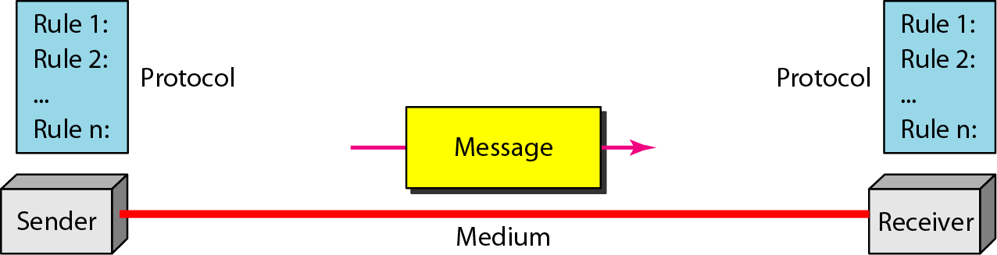
Five Components of Data Communication
Message: Information(data) to be communicated
Sender
Receiver
Transmission medium: Physical path by which a message travels
Protocol: A set of rules that govern data communication

Slide 7
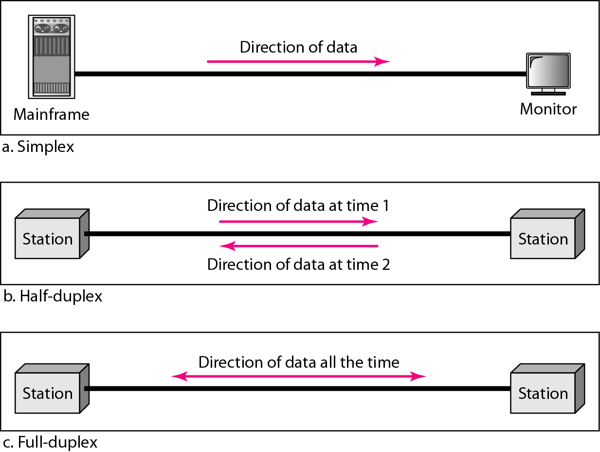
Direction of Data Flow

Slide 8
Data Flow
Simplex
Unidirectional
As on a one-way street
Half-duplex
Both transmit and receive possible, but not at the same time
Like a one-lane road with two-directional traffic
Walkie-talkie, CB radio
Full-duplex
Transmit and receive simultaneously
Like a two-way street, telephone network
Channel capacity must be divided between two directions

Slide 9
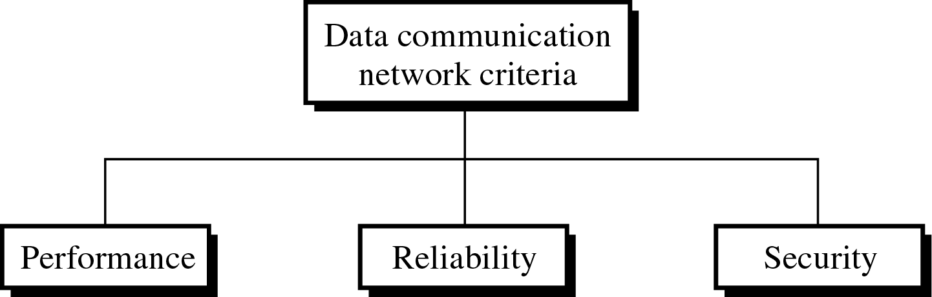
Network
Network: A set of devices (nodes) connected by communication links
Node: Computer, printer, or any device capable of sending and/or receiving data
To be considered effective and efficient, a network must meet a number of criteria

Slide 10
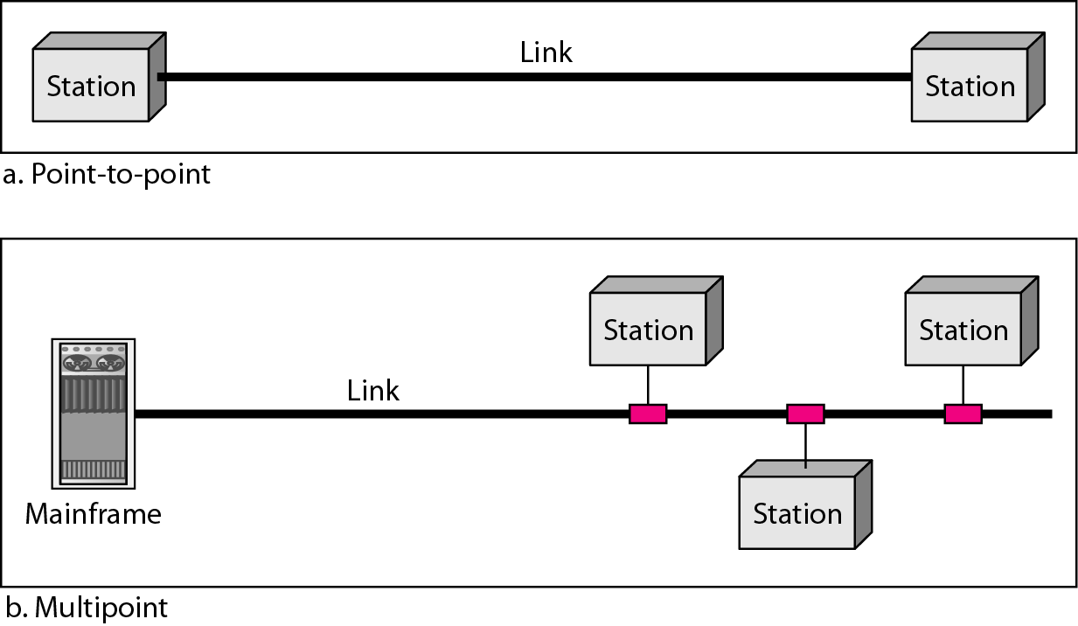
Type of Connection

Slide 11
Type of Connection
Point-to-point
Dedicated link between two devices
The entire capacity of the channel is reserved
Ex) Microwave link, TV remote control
Multipoint
More than two devices share a single link
Capacity of the channel is either
Spatially shared: Devices can use the link simultaneously
Timeshare: Users take turns

Slide 12
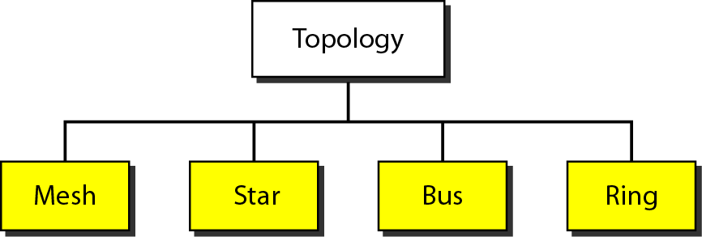
Physical Topology
Network Topology refers to layout of a network. How different nodes in a network are connected to each other and how they communicate is determined by the network's topology

Slide 13
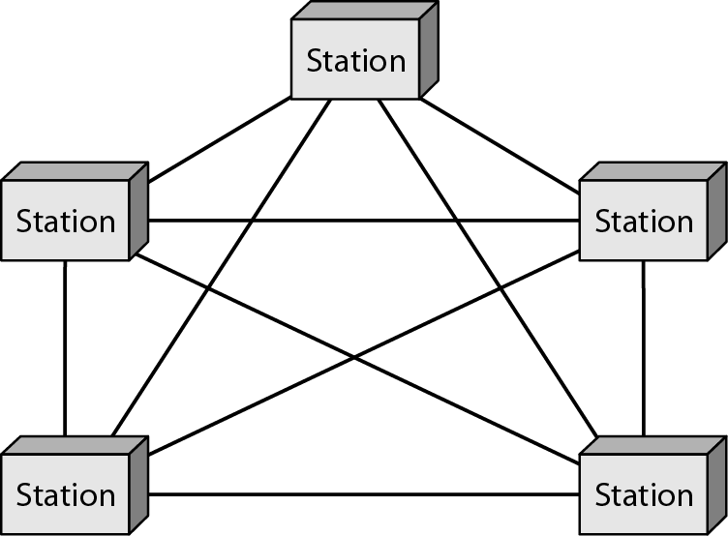
Mesh Topology
Dedicated point-to-point link to every other nodes
A mesh network with n nodes has n(n-1)/2 links. A node has n-1 I/O ports (links)
Advantages: No traffic problems, robust, security, easy fault identification & isolation
Disadvantages: Difficult installation/reconfiguration, space, cost

Slide 14
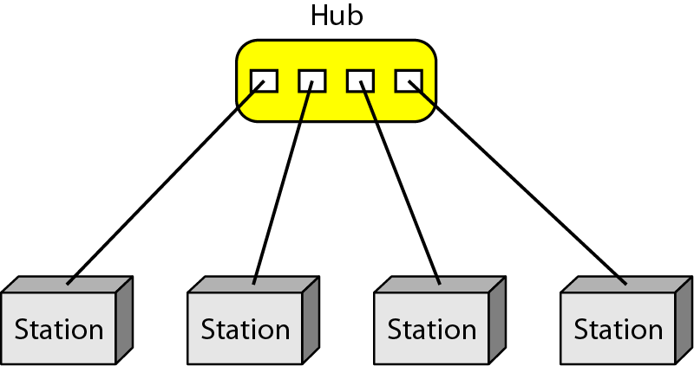
Star Topology
Dedicated point-to-point link only to a central controller, called a hub
Hub acts as an exchange: No direct traffic between devices
Advantages: Less expensive, robust
Disadvantages: dependency of the whole on one single point, the hub
For a better idea watch this video : https://www.youtube.com/watch?v=1z0ULvg_pW8

Slide 15
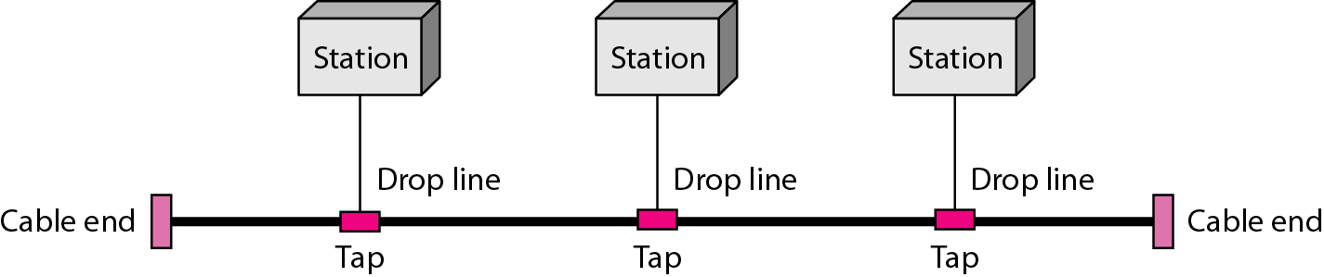
Bus Topology
One long cable that links all nodes
tap, drop line, cable end
limit on the # of devices, distance between nodes
Advantages: Easy installation, cheap
Disadvantages: Difficult reconfiguration, no fault isolation, a fault or break in the bus stops all transmission

Slide 16
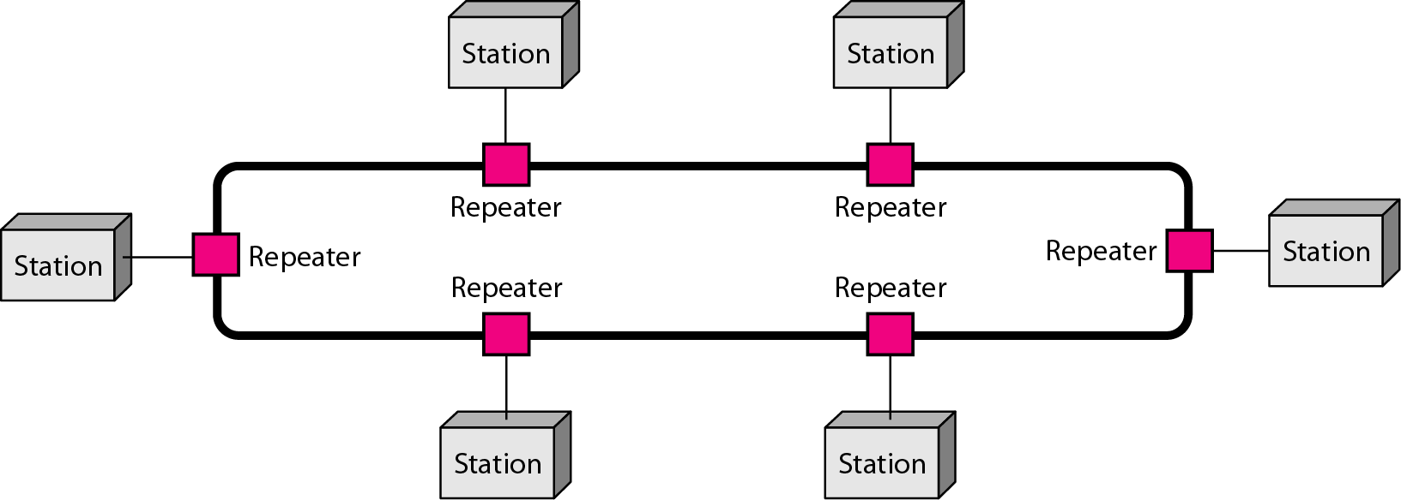
Ring Topology
Dedicated point-to-point link only with the two nodes on each sides
One direction, repeater
Advantages: Easy reconfiguration, fault isolation
Disadvantage: Unidirectional traffic, a break in the ring cab disable the entire network

Slide 17
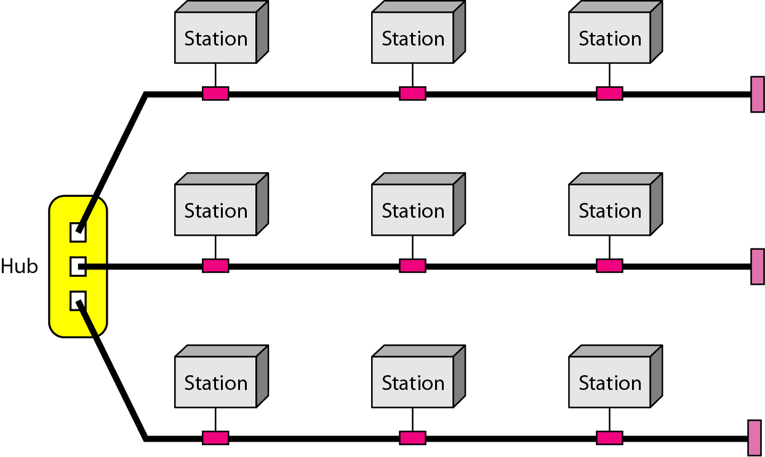
Hybrid Topology
Example: Main star topology with each branch connecting several stations in a bus topology
To share the advantages from various topologies

Slide 18
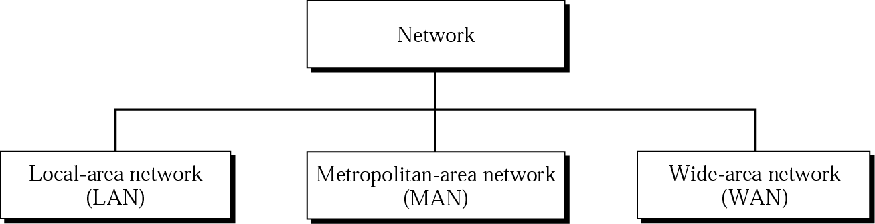
Categories of Networks

Slide 19
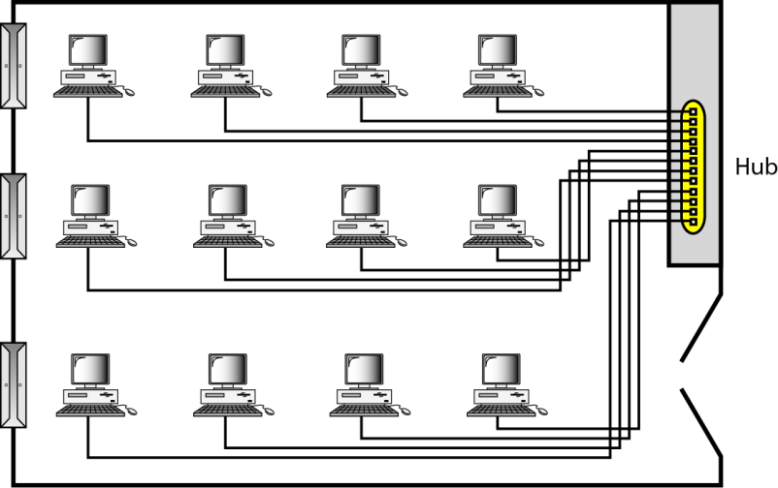
LAN
Usually privately owned
A network for a single office, building, or campus ≤ a few Km
Common LAN topologies: bus, ring, star
An isolated LAN connecting 12 computers to a hub in a closet

Slide 20
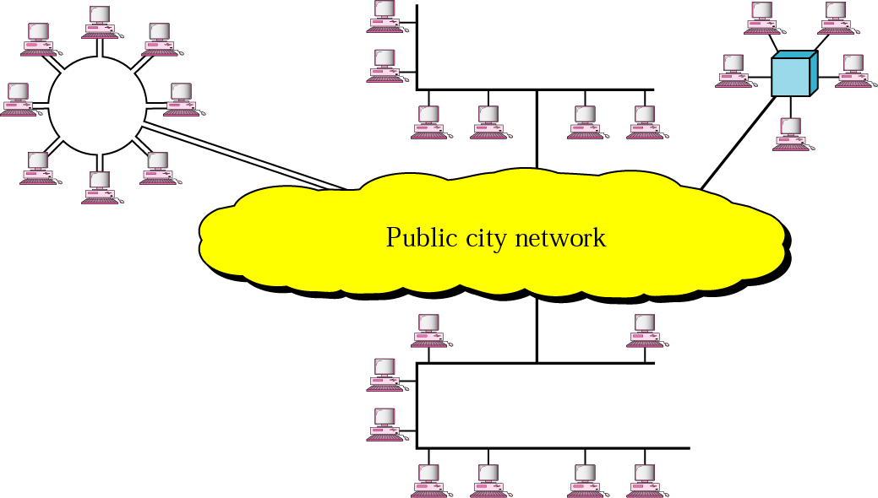
MAN
Designed to extend to an entire city
Cable TV network, a company’s connected LANs
Owned by a private or a public company

Slide 21
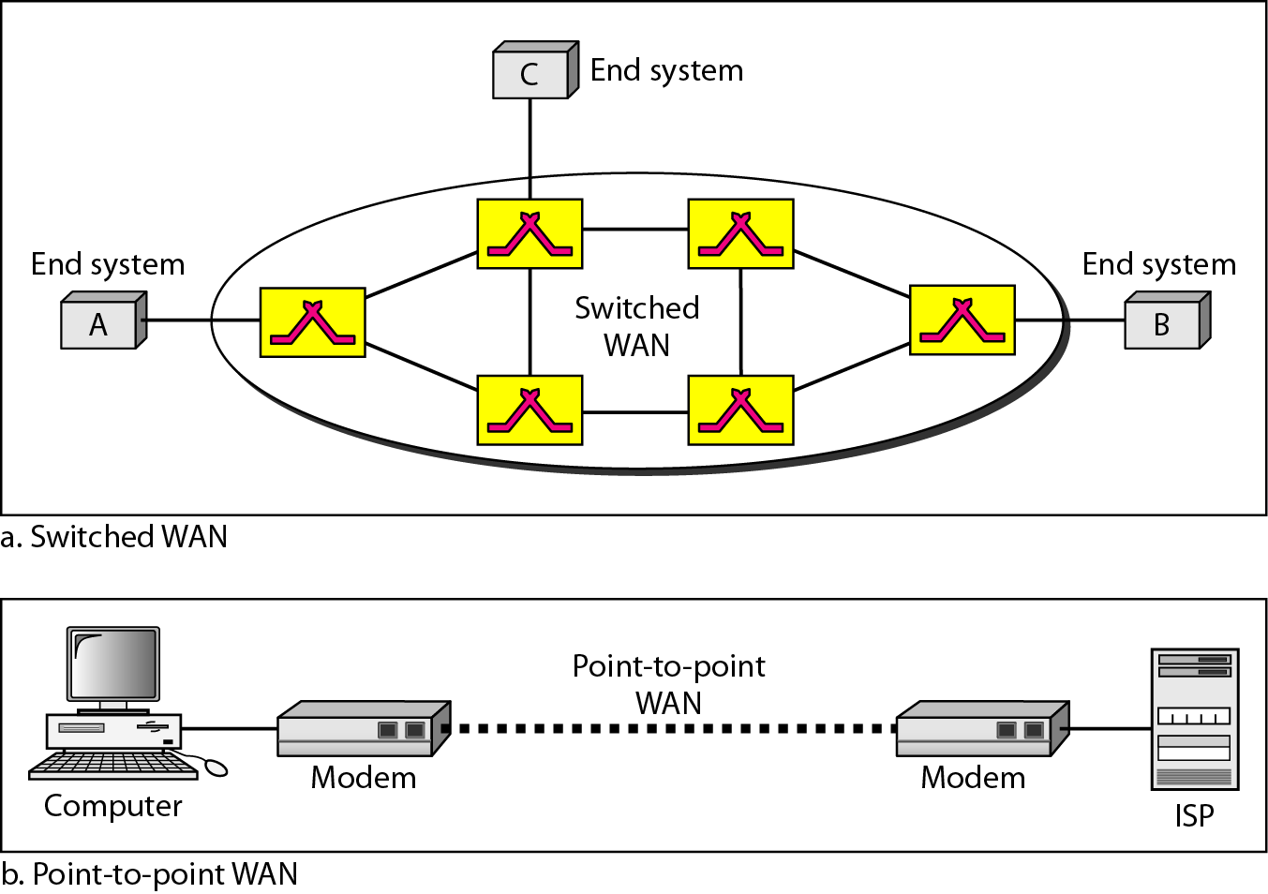
WAN
Long distance transmission, e.g., a country, a continent, the world
Enterprise network: A WAN that is owned and used by one company

Slide 22
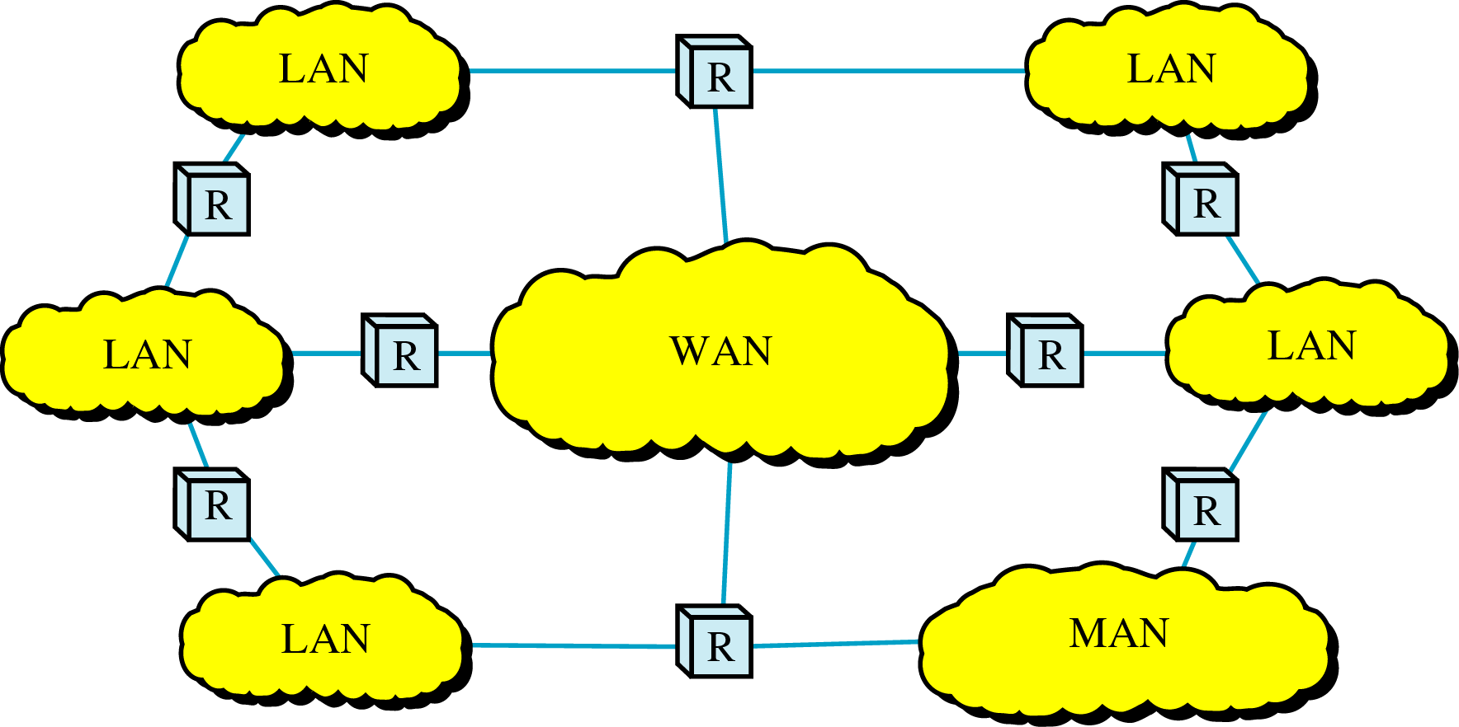
Internetwork
Internetwork (internet) : two or more networks are connected by internetworking devices
Internetworking devices: router, gateway, etc.
The Internet: a specific worldwide network

Slide 23
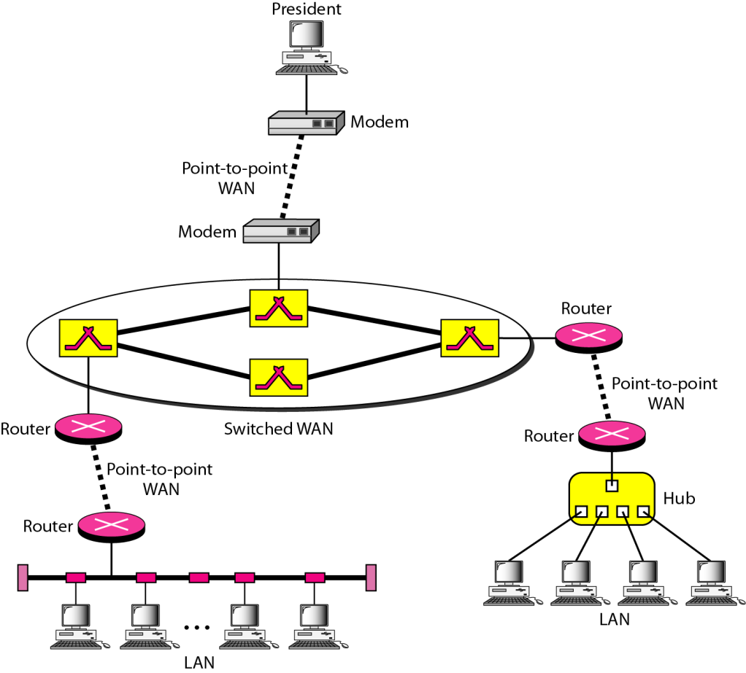
Internetwork Example
A heterogeneous network : four WANs and two LANs

Slide 24
The Internet
The Internet has revolutionized many aspects of our daily lives. It has affected the way we do business as well as the way we spend our leisure time. The Internet is a communication system that has brought a wealth of information to our fingertips and organized it for our use.
1967: ARPANET proposed by DoD’s ARPA(Advanced Research Project Agency)
1969: ARPANET in a reality: UCLA, UCSB, SRI, U. of Utah
1973: Vint Cerf and Bob Kahn propose TCP,
To split TCP into two protocols TCP and IP

Slide 25
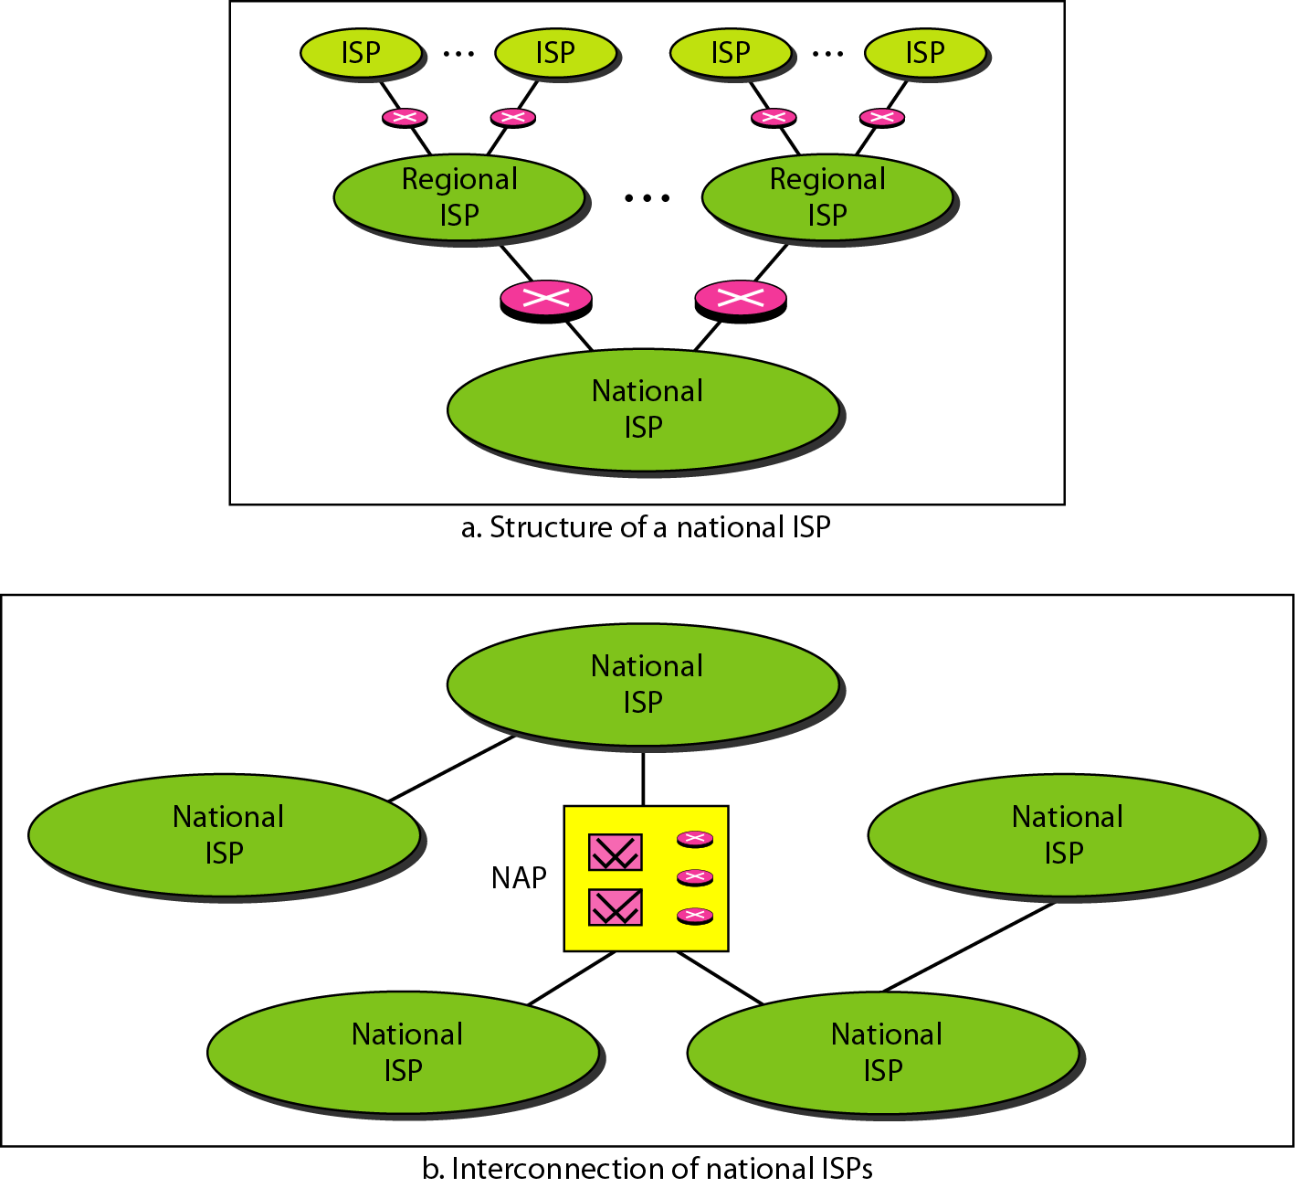
Internet Today
ISP (Internet service providers)
NISP (national ISP)
NAP (network access point)
Peering point

Slide 26
Protocols
Protocol : rule
A set of rules that govern data communication
For communication to occur, entities must agree upon a protocol
A protocol defines what is communicated, how is communicated and when is communicated.
Key elements of a protocol
Syntax: structure or format of data
Semantics: meaning of each section in the structure
Timing: when and how fast data should be sent

Slide 27
Standards: agreed-upon rules
Standards is essential in
Creating/maintaining open and competitive markets
Guaranteeing national/international interoperability
Two categories
De jure (“by law” or “by regulation’) standards
De facto (“by fact” or ‘by convention’) standards
Proprietary standards: closed standards. Owned and controlled by one company.
Nonproprietary standards: open standards. not registered or protected as a trademark or brand name
proprietary standards are privately owned by one or more entities that control their distribution and access. Open standards let people and organizations set up new services and make them available across the rest of the Internet without permission.

Slide 28
Standards Organizations
Standards are developed by
Standards creation committees
Forums
Regulatory agencies
Standards committees & forums
Standards committees are slow moving
Forums are made up of interested corporations
Forum are able to speed acceptance of a particular technology

Slide 29
Standards Committees
ISO
Voluntary international organization
ITU-T
Formerly, CCITT formed by UN
ANSI
Private non-profit corporation in the US
IEEE
The largest engineering society in the world
EIA
Non-profit organization in the US

Slide 30
Internet Standards
An internet standard (STD) is a specification that has been approved by the Internet Engineering Task Force (IETF). Such standard helps to promote a consistent and universal use of the internet worldwide.
IETF (Internet Engineering Task Force)
Internet Draft.
A specification begins as an Internet draft
working document with no official status
with a 6-month lifetime
RFC (Request for Comment)
Upon recommendation from the Internet authorities, a draft may be published as a Request for Comment (RFC)
Edited, assigned a number, and made available to all interested parties

Slide 31
Internet Standards
Prior to approval, the proposed internet standard goes through a series of stages called a “standards track.” The standard first starts as a draft, which may evolve into an RFC (Request for Comments). If the IETF approves the RFC, then it becomes a standard.
RFCs and proposed internet standards cover a lot of ground. From standards for handling technical TCP/IP processes to standards for the display of various types of media, the IETF weighs in on a large number of these standards as they make their way toward adoption.
A list of proposed standards can be found at RFC-editor.org

Slide 32
Home Works
Page 24
Problems – 15, 16, 17, 19
Page 25
Problems – 20, 22, 25, 26, 28, 29

Slide 33
Reference
Data Communications and Networking
Behrouz A. Forouzan,
4th EditionMcGraw-Hill (Chap - 1)
A clear idea about Hub, Switches and Routers - https://www.youtube.com/watch?v=1z0ULvg_pW8

